Slide 1
Lecture 11
Inside the Computer –
Transistors and Integrated Circuits

Slide 2
Electricity and Switches
modern computers are powered by electricity, using electrical signals to store and manipulate information
the components of a computer require electrical power to carry out their assigned task
  electricity generates the light that shines through a computer screen, illuminating the individual pixels that make up images and letters
  electricity runs the motor that spins the hard-drive disk, allowing information to be accessed
  main memory and CPU employ electrical signals to store and manipulate data
  bit patterns are represented by the presence or absence of electrical current along a wire

Slide 3
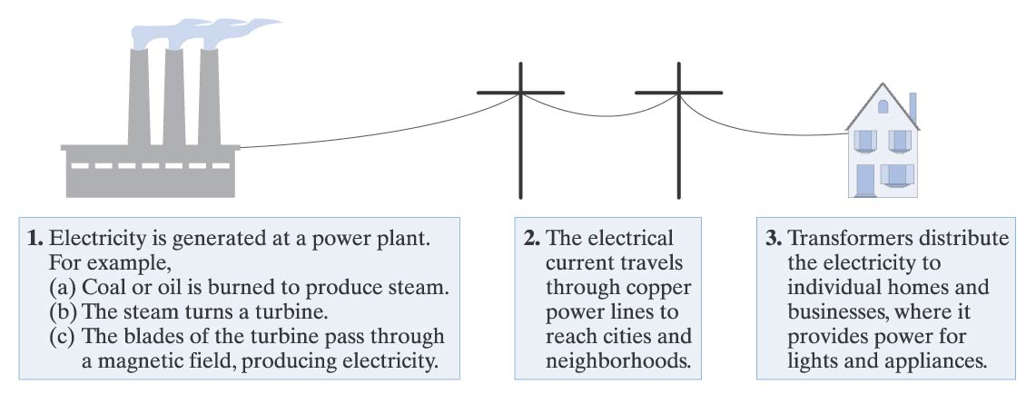
Electricity Basics
electricity is a flow of electrons, the negatively charged particles in atoms, through a medium
  good conductors of electricity allow for the flow of electrons with little resistance (e.g., copper, silver, gold)
  other elements, especially nonmetals, are poor conductors (e.g., carbon, oxygen)
electricity can be quantified in amperes or voltage
  amperes gauge electron flow: 1 amp is equal to 6.24 quintillion electrons flowing past a given point each second
  voltage measures the physical force produced by the flow of electrons: standard household in United States has 110 to 120 volt outlets

Slide 4
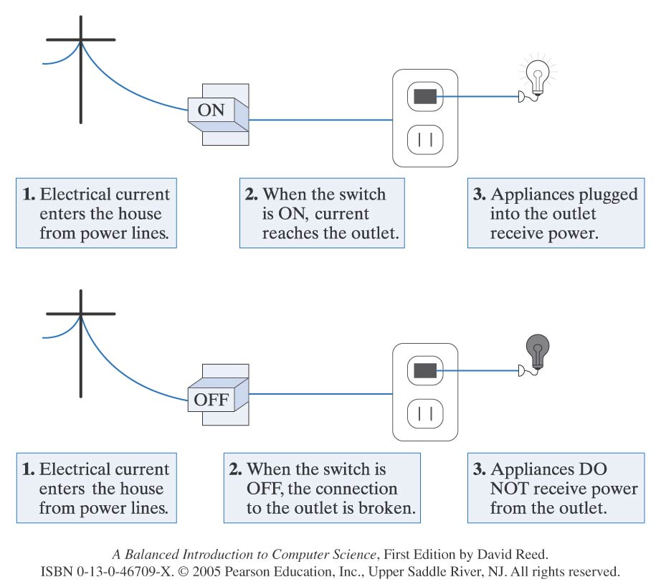
Switches
the most basic tool for controlling the flow of electricity is a switch
  a switch can be flipped to connect or disconnect two wires, thus regulating the flow of electricity between them
example: a light switch on a wall serves as an intermediary between the power line entering your home and the outlet that operates a lighting fixture
  if the switch is turned on, then the wires that link the outlet to the power line are connected, and the lighting fixture receives electricity
  if the switch is turned off, then the connection is interrupted, and no power reaches the outlet

Slide 5
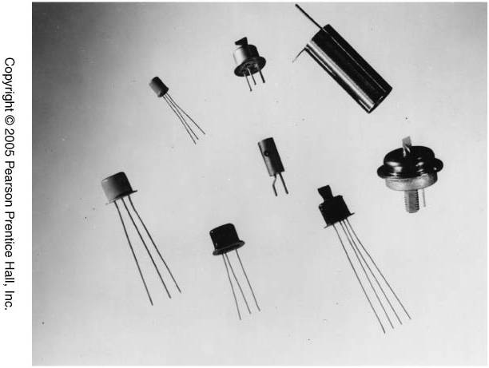
Transistors
as we saw in Chapter 6, advances in switching technology have defined the generations of computers
  1930’s – electromagnetic relays served as physical switches, whose on/off positions were controlled by the voltage to a magnet
  1940’s – vacuum tubes replaced relays, which were faster (since no moving parts) but tended to overheat and burn out frequently
  1948 – the transistor was developed by Bardeen, Brattain, and Shickley
    a transistor is a solid piece of metal attached to a wire that serves as a switch by alternatively conducting or resisting electricity
    transistors allowed for the development of smaller, faster machines at a lower cost
semiconductors are metals that can be manipulated to be either good or bad conductors of electricity
  the first transistors were made of germanium and gold, but modern transistors are constructed from silicon
  through a process known as doping, impurities are added to a slab of silicon, causing the metal to act as an electrical switch

Slide 6
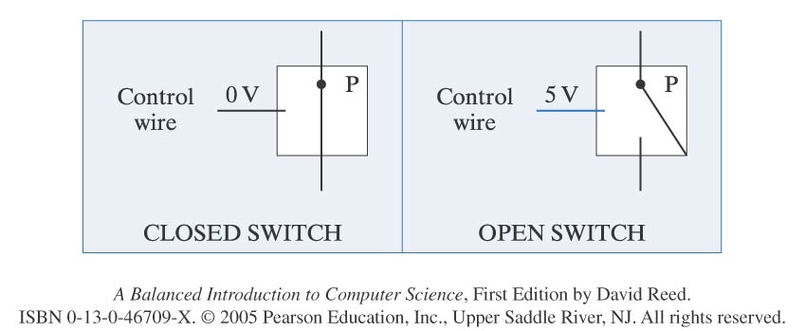
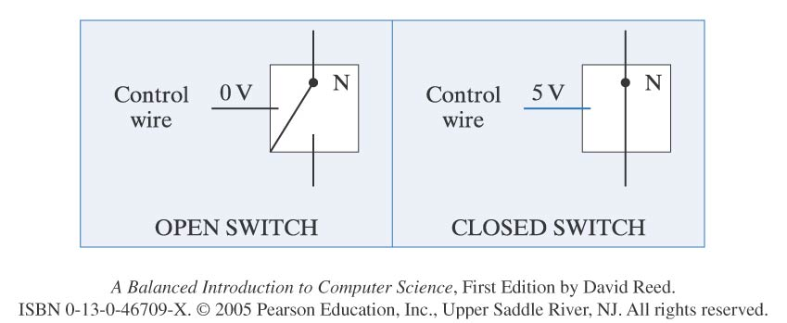
Transistors as Switches
a PMOS transistor is positively doped, so that the switch is "closed" when there is no current on the control wire, but "opens" when current is applied
an NMOS transistor is negatively doped, so that the switch is "open" when there is no current, but "closes" when there is current

Slide 7
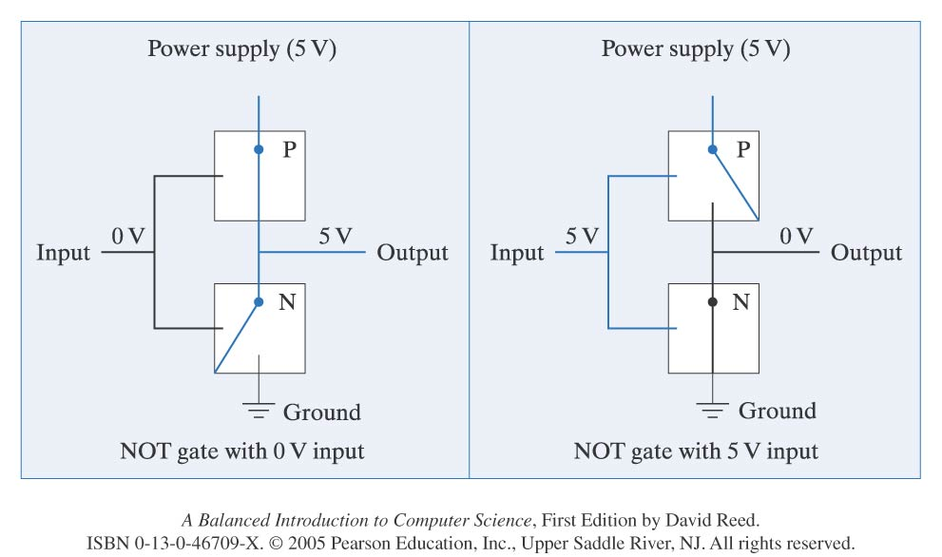
From Transistors to Gates
transistors can be combined to form a circuit, which controls the flow of electricity in order to produce a particular behavior
example: consider the following circuit combining two transistors
  if no current (0 volts) is applied to the input wire, the PMOS transistor will close to allow current to travel on the output wire, and the NMOS transistor will open to disconnect the ground
  if current (5 volts) is applied to the input wire, the PMOS transistor will open to disconnect the output wire, and the NMOS transistor will close to ground the input
  the end result is that the output is the opposite of the input
  this circuit known as a NOT gate

Slide 8
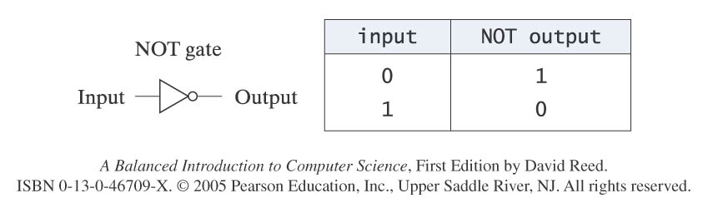
Gates and Binary Logic
the term “gate” suggests a simple circuit that controls the flow of electricity
  in the case of a NOT gate, the flow of electricity is manipulated so that the output signal is always opposite of the input signal
  we can think of a gate as computing a function of binary values
    0 represents no current; 1 represents current
    the symbol to the left (triangle w/ circle) is often used to denote a NOT gate
    the truth table to the right describes the mapping of input to output
  note: NOT gates invert voltages in the same way that the JavaScript NOT operator (!) inverts Boolean values
    0 corresponds to false; 1 corresponds to true

Slide 9
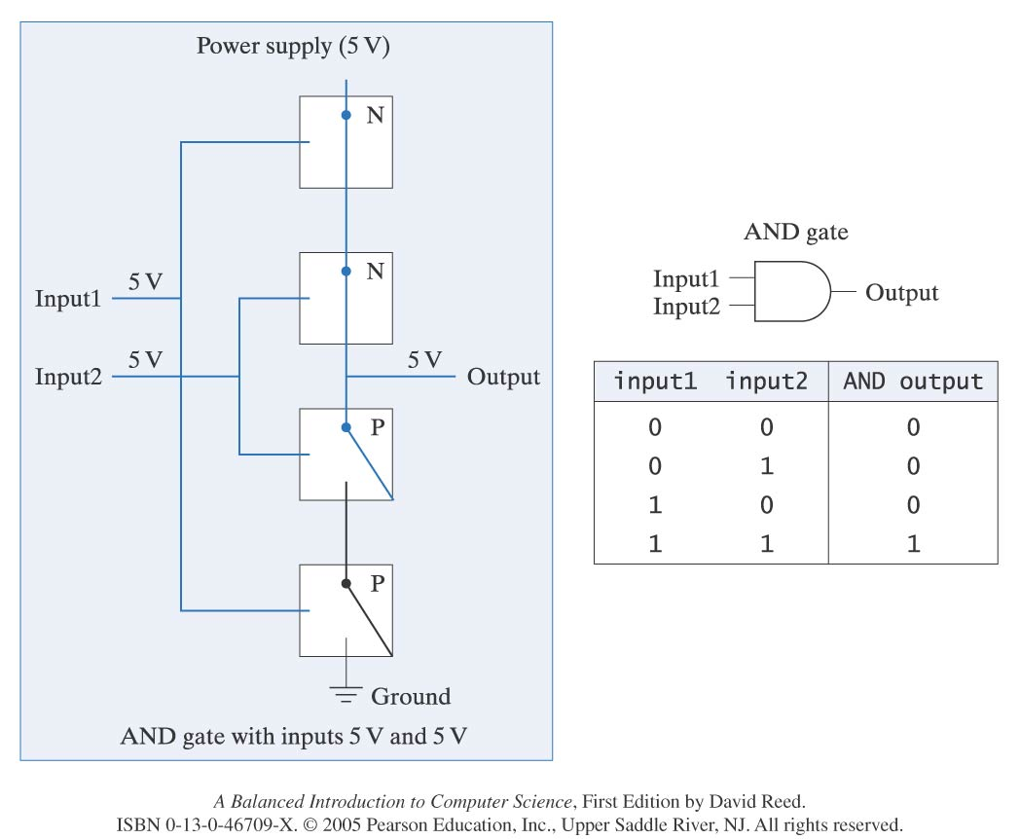
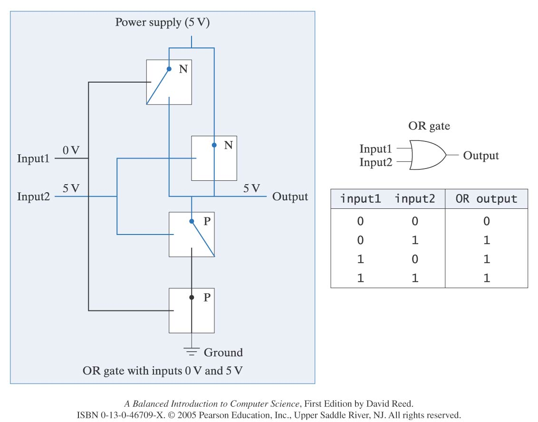
Gates and Binary Logic
many other simple circuits can be defined to perform useful tasks
  AND gate – produces voltage on its output wire if both input wires carry voltage
  OR gate – produces voltage on its output wire if either input wire carries voltage
  AND, OR, and NOT gates can be combined to construct all the circuitry required to store and manipulate information within a computer

Slide 10
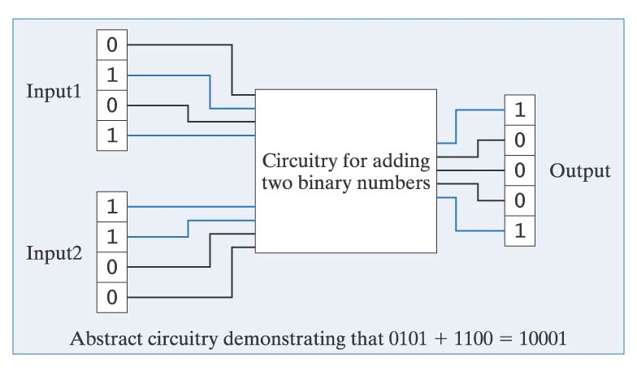
From Gates to Circuits
transistors are connected to form basic logic gates, which are then combined to build more advanced circuitry
example: adding two binary numbers
  we can represent a 4-bit binary number using 4 wires
  current on a wire signifies a 1 bit for that place; no current signifies 0

Slide 11

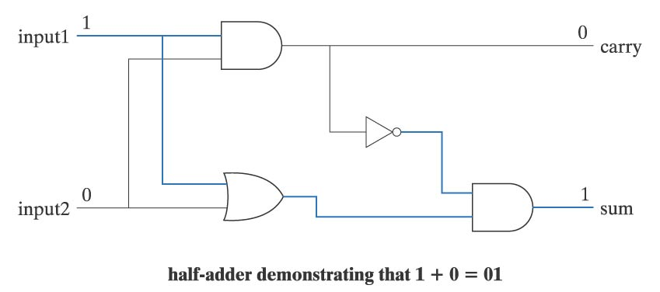
Half-adder Circuit
recall the rules of binary addition
although binary addition is relatively straightforward, designing a circuit for adding binary numbers is quite complex
  instead of starting at the transistor level, we can use AND, OR, and NOT gates
  focus first on the addition of 2 bits
    requires two input lines, two output lines (sum of inputs and possible carry)
    the circuit consist of four gates (known as a half-adder)

Slide 12
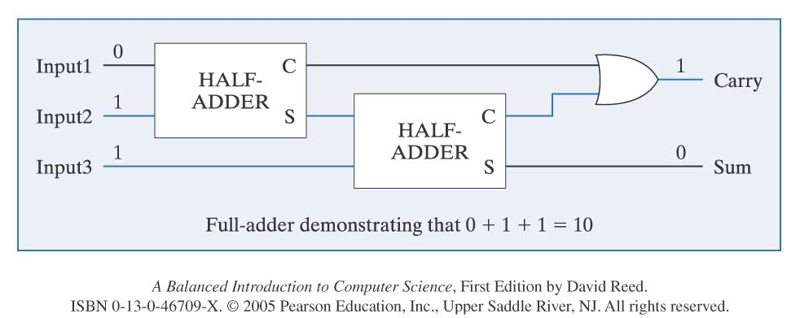
Full-adder Circuit
the term “half-adder” refers to the fact that when you add binary numbers containing more than one bit, summing the corresponding bit pairs by column is only half the job
  you must also consider that a bit might be carried over from the previous addition
  using half-adders and logical gates as building blocks, we can design a circuit that takes this into account (known as a full-adder)

Slide 13
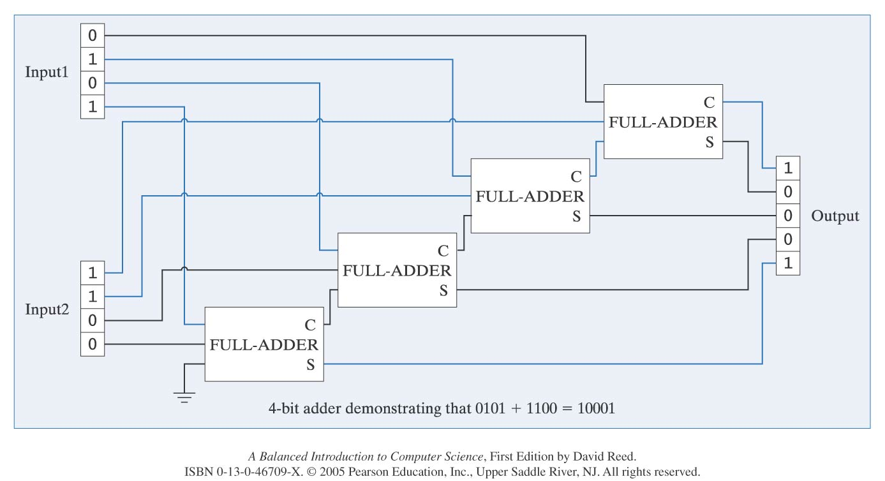
4-bit Adder Circuit
using full-adders as building blocks, we can design a more complex circuit that sums two 4-bit numbers
  since a full-adder is required to add each corresponding bit pair together (along with possible carry), the circuit will need four full-adders wired together

Slide 14
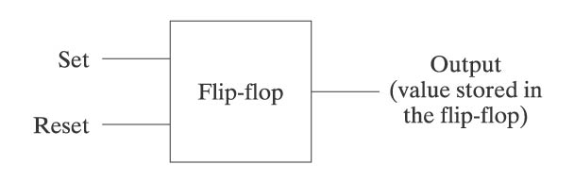
Designing Memory Circuitry
main memory and registers within the CPU are composed of circuitry
  whereas adders manipulate inputs to produce outputs, memory circuits must maintain values over time
  the simplest circuit for storing a value is known as a flip-flop
    it can be set to store a 1 by applying current on an input wire
    it can be reset to store a 0 by applying current on another input wire

Slide 15
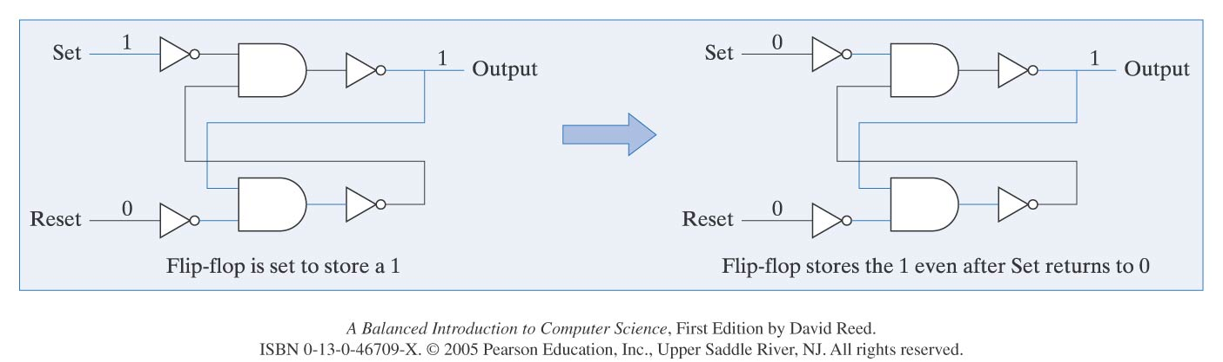
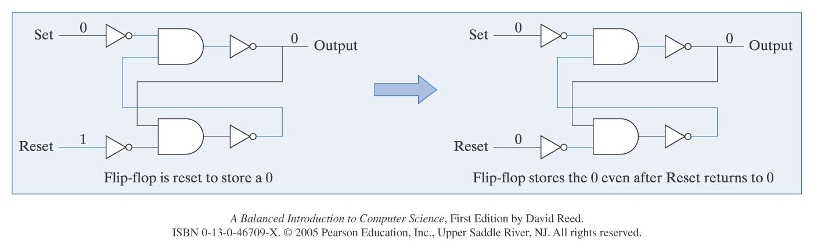
Flip-flop Circuit
a flip-flop stores a value by feeding the output currents back into the circuit
  the value is maintained by current flowing around and around the circuit
  a current on the Set wire produces current on the output, which then cycles
  a current on the Reset wire produces no current on the output

Slide 16
Summary
Controllable Switches are easy to make
  There are many kinds of controllable switches.
    For example: NMOS, PMOS switches
These switches can be used to put together to make “Logic Gates”:
  AND, OR, NOT
Logic Gates can be put together to make half adder, full adders and multi-bit adders
  So we can see they can be used for other such circuits as well
Logic Gates can be used to make circuits that “remember” or store data
  flop-flop circuit
A Computer includes the following most important units:
  An ALU (Arithmetic Logic Unit)
  Instruction Decoding and associated circuits
  Memory
  Stored Program

Slide 17
Components of a basic computer
Memory
ALU
(Arithmetic/Logic Unit:
Basic operations
Data
Control and Decoding
Program

Slide 18
Boolean Functions
We can interpret high or low voltage as representing true or false.
A variable whose value can be either 1 or 0 is called a Boolean variable.
A Boolean function has one or more input Boolean variables and yields results based on the values of these variables.
A Boolean function of n variables has 2^{n} possible combinations of the input value. These combinations can be expressed in an expression or a table called a truth table.

Slide 19
Simple Boolean Function -- AND
Function f : {0,1}² → {0,1}¹
Boolean algebra notation for AND:
x1 AND x2 ⬄ x1*x2
x1 AND x2 ⬄ x1•x2
x1 AND x2 ⬄ x1 x2
So we can express the function as
f(x1, x2)=x1*x2
f(x1, x2)=x1•x2
f(x1, x2)=x1 x2
Truth Table
x1 x2 | x1 AND x2
0 0 | 0
0 1 | 0
1 0 | 0
1 1 | 1

Slide 20
Simple Boolean Function -- OR
Function f : {0,1}² → {0,1}¹
Boolean algebra notation for OR:
x1 OR x2 ⬄ x1+x2
So we can express the function as
f(x1, x2)=x1+x2
Truth Table
x1 x2 | x1 OR x2
0 0 | 0
0 1 | 1
1 0 | 1
1 1 | 1

Slide 21

Simple Boolean Function -- NOT
Function f : {0,1}¹ → {0,1}¹
Boolean algebra notation for NOT:
NOT x ⬄ ~x
NOT x ⬄ x’
NOT x ⬄
So we can express the function as
f(x))=~x
f(x)=x’
f(x)=
Truth Table
x | !x
0 | 1
1 | 0

Slide 22
Precedence
Precedence are important, but not too difficult.
  NOT has the highest precedence, followed by AND, and then OR.
  For example, the following two functions would generate different results due to the order of operations performed.
    f(x,y,z) = x + y’ z + x’
    g(x,y,z) = (x + y’) z + x’

Slide 23



Primitive logic gates
Each of our basic operations can be implemented in hardware using a primitive logic gate.
  Symbols for each of the logic gates are shown below.
  These gates output the product, sum or complement of their inputs.
NOT
(complement)
on one input
Operation:
AND (product)
of two inputs
OR (sum) of two inputs
Expression:
xy, or x•y
x + y
x’
Logic gate:

Slide 24
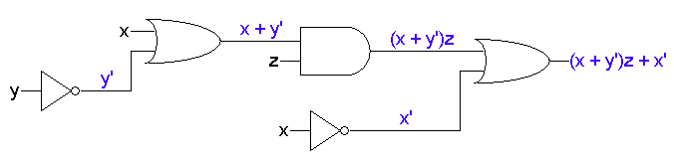
Expressions and circuits
Any Boolean expression can be converted into a circuit by combining basic gates in a relatively straightforward way.
The diagram below shows the inputs and outputs of each gate.
The precedence are explicit in a circuit. Clearly, we have to make sure that the hardware does operations in the right order!
F(x, y)=(x + y’)z + x’

Slide 25
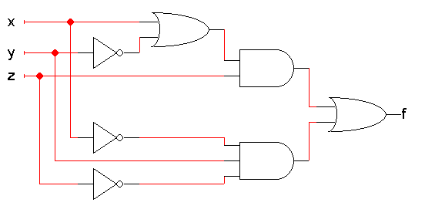
Circuit analysis
Circuit analysis involves figuring out what some circuit does.
  Every circuit computes some function, which can be described with Boolean expressions or truth tables.
  So, the goal is to find an expression or truth table for the circuit.
The first thing to do is figure out what the inputs and outputs of the overall circuit are.
  This step is often overlooked!
  The example circuit here has three inputs x, y, z and one output f.

Slide 26
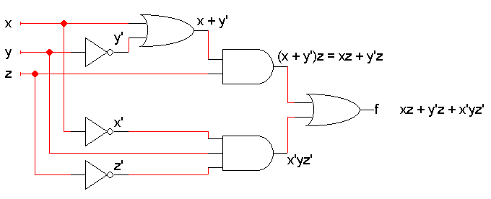
Write algebraic expressions...
Next, write expressions for the outputs of each individual gate, based on that gate’s inputs.
  Start from the inputs and work towards the outputs.
  It might help to do some algebraic simplification along the way.
Here is the example again.
  We did a little simplification for the top AND gate.
  You can see the circuit computes f(x,y,z) = xz + y’z + x’yz’

Slide 27
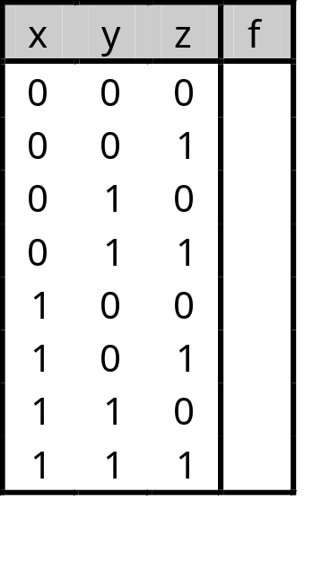
...or make a truth table
It’s also possible to find a truth table directly from the circuit.
Once you know the number of inputs and outputs, list all the possible input combinations in your truth table.
  A circuit with n inputs should have a truth table with 2^{n} rows.
  Our example has three inputs, so the truth table will have 2³ = 8 rows. All the possible input combinations are shown.

Slide 28
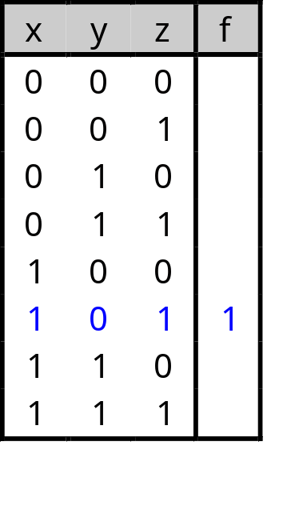
Simulating the circuit
Then you can simulate the circuit, either by hand or with a program, to find the output for each possible combination of inputs.
For example, when xyz = 101, the gate outputs would be as shown below.
  Use truth tables for AND, OR and NOT to find the gate outputs.
  For the final output, we find that f(1,0,1) = 1.
1
1
1
0
1
1
0
1
0
0

Slide 29
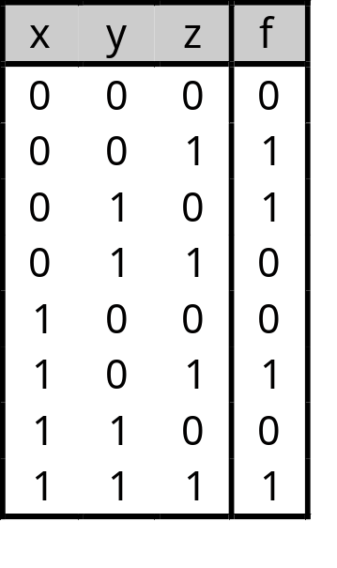
Finishing the truth table
Doing the same thing for all the other input combinations yields the complete truth table.
This is simple, but tedious.

Slide 30
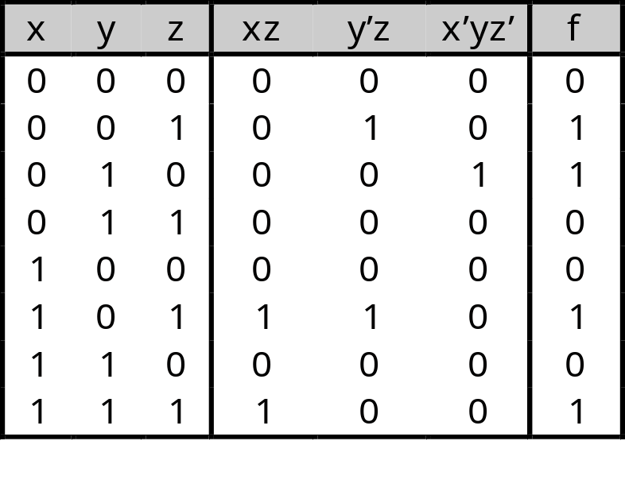
Expressions and truth tables*
Remember that if you already have a Boolean expression, you can use that to easily make a truth table.
For example, since we already found that the circuit computes the function f(x,y,z) = xz + y’z + x’yz’, we can use that to fill in a table:
  We show intermediate columns for the terms xz, y’z and x’yz’.
  Then, f is obtained by just OR’ing the intermediate columns.
Notes:
Actually, the opposite is also true: it’s easy to come up with an expression if you already have a truth table.

Slide 31



Circuit analysis summary
After finding the circuit inputs and outputs, you can come up with either an expression or a truth table to describe what the circuit does.
You can easily convert between expressions and truth tables.
Find the circuit’s
inputs and outputs
Find a Boolean
expression
for the circuit
Find a truth table
for the circuit

Slide 32
Boolean operations summary
A variable whose value can be either 1 or 0 is called a Boolean variable.
AND, OR, and NOT are the basic Boolean operations.
We can express Boolean functions with either an expression or a truth table.
Every Boolean expression can be converted to a circuit.
Now, we’ll look at how Boolean algebra can help simplify expressions, which in turn will lead to simpler circuits.

Slide 33
Expression simplification
Normal mathematical expressions can be simplified using the laws of algebra
For binary systems, we can use Boolean algebra, which is superficially similar to regular algebra
There are many differences, due to
  having only two values (0 and 1) to work with
  having a complement operation
  the OR operation is not the same as addition

Slide 34
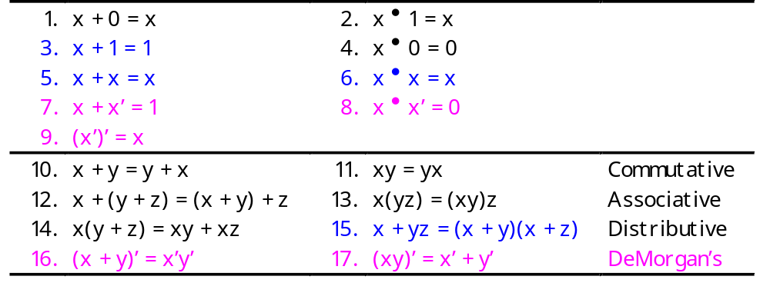
Formal definition of Boolean algebra*
A Boolean algebra requires
  A set of elements B, which needs at least two elements (0 and 1)
  Two binary (two-argument) operations OR and AND
  A unary (one-argument) operation NOT
  The axioms below must always be true
  The pink axioms deal with the complement operation
  Blue axioms (especially 15) are different from regular algebra
Notes:
f(x,y,z) = x’y’z + x’yz’ + xy’z + xyz
= x’y’z + x’yz + x(y’+y)z
= x’y’z + x’yz + xz

Slide 35
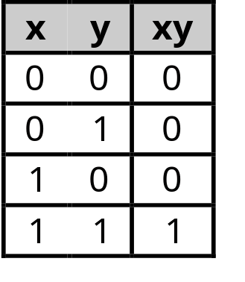
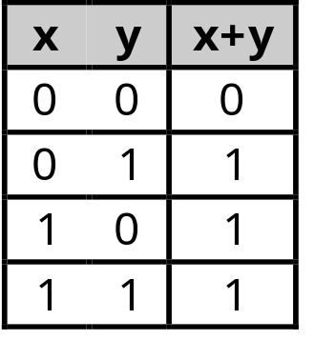
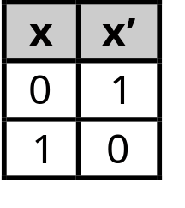
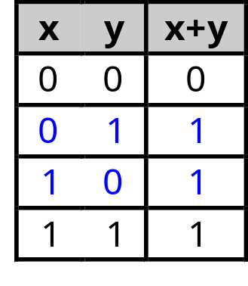
Are these axioms for real?
We can show that these axioms are true, given the definitions of AND, OR and NOT
The first 11 axioms are easy to see from these truth tables alone. For example, x + x’ = 1 because of the middle two lines below (where y = x’)

Slide 36
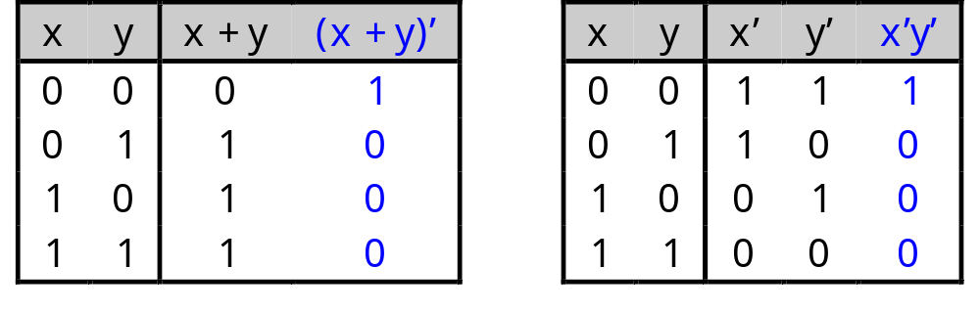
Proving the rest of the axioms
We can make up truth tables to prove (both parts of) DeMorgan’s law
For (x + y)’ = x’y’ we can make truth tables for (x + y)’ and for x’y’
In each table, the columns on the left (x and y) are the inputs. The columns on the right are outputs.
In this case, we only care about the columns in blue. The other “outputs” are just to help us find the blue columns.
Since both of the columns in blue are the same, this shows that (x + y)’ and x’y’ are equivalent

Slide 37
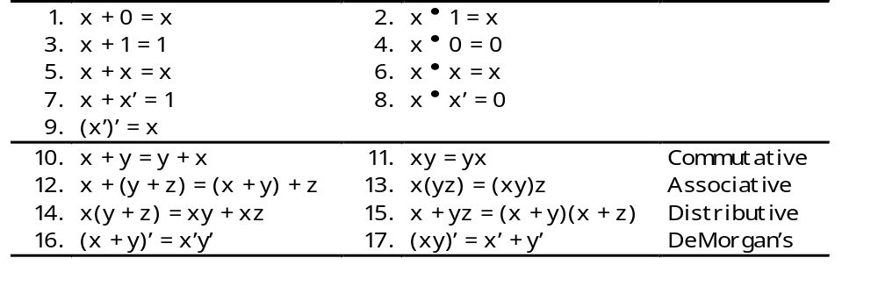
Simplification with axioms
We can now start doing some simplifications
x’y’ + xyz + x’y
= x’(y’ + y) + xyz [ Distributive; x’y’ + x’y = x’(y’ + y) ]
= x’•1 + xyz [ Axiom 7; y’ + y = 1 ]
= x’ + xyz [ Axiom 2; x’•1 = x’ ]
= (x’ + x)(x’ + yz) [ Distributive ]
= 1 • (x’ + yz) [ Axiom 7; x’ + x = 1 ]
= x’ + yz [ Axiom 2 ]
Notes:
f(x,y,z) = x’y’z + x’yz’ + xy’z + xyz
= x’y’z + x’yz’ + x(y’+y)z
= x’y’z + x’yz’ + xz

Slide 38
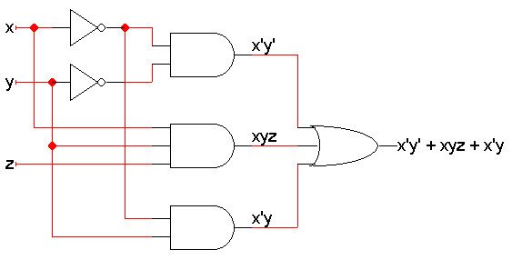
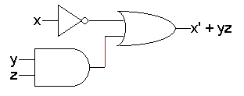
Let’s compare the resulting circuits
Here are two different but equivalent circuits.
In general the one with fewer gates is “better”:
  It costs less to build
  It requires less power
  But we had to do some work to find the second form

Slide 39
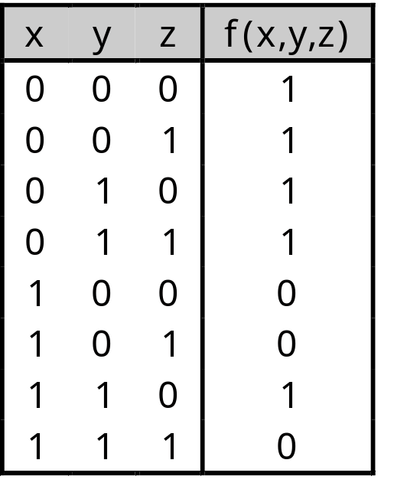
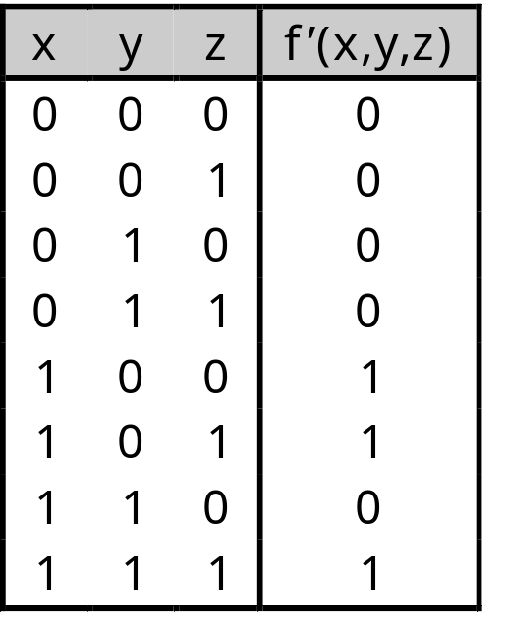
The complement of a function
The complement of a function always outputs 0 where the original function outputted 1, and 1 where the original produced 0.
In a truth table, we can just exchange 0s and 1s in the output column(s)
f(x,y,z) = x(y’z’ + yz)

Slide 40
Exercise 1
F(x1, x2, x3) = (x1 *x2) + ( ~x1*x3)
What is the truth table? Logic circuit?

Slide 41
Truth Table
x1 x2 x3 | F
0 0 0 | 0
0 0 1 | 1
0 1 0 | 0
0 1 1 | 1
1 0 0 | 0
1 0 1 | 0
1 1 0 | 1
1 1 1 | 1
f(x1, x2, x3) = (x1 *x2) + ( ~x1*x3)

Slide 42


Logic Circuit
f(x1, x2, x3) = (x1 *x2) + ( ~x1*x3)
x1
x2
x3

Slide 43
Exercise 2
F: {0, 1}³ →{0,1}²
F1 = x + y’.z
F2 = x’.y’.z + x’.y.z + x.y’
F2 can be simplified as
F2 = x’.z(y’ + y) + x.y’ = x’.z + x.y’

Slide 44
Exercise 2 -- Truth table
x y z F1 F2
0 0 0 0 0
0 0 1 1 1
0 1 0 0 0
0 1 1 0 1
1 0 0 1 1
1 0 1 1 1
1 1 0 1 0
1 1 1 1 0
A Boolean Function can be represented in only one truth table forms!

Slide 45
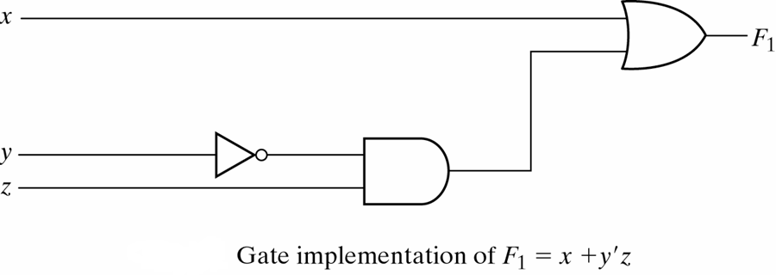
Exercise 2 – logical gate for F1
y’
Y’.z

Slide 46
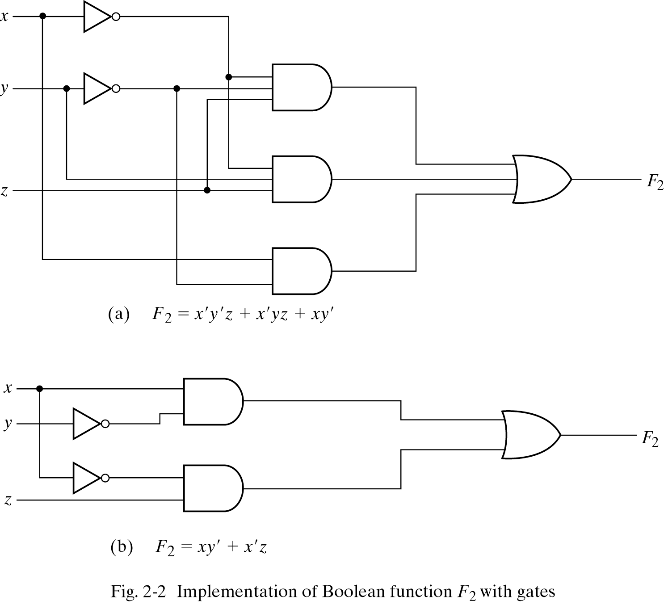
Exercise 2 – logical gate for F2
X’.y’.z
X’.y.z
X.y’
X.y’
X’.z

Slide 47
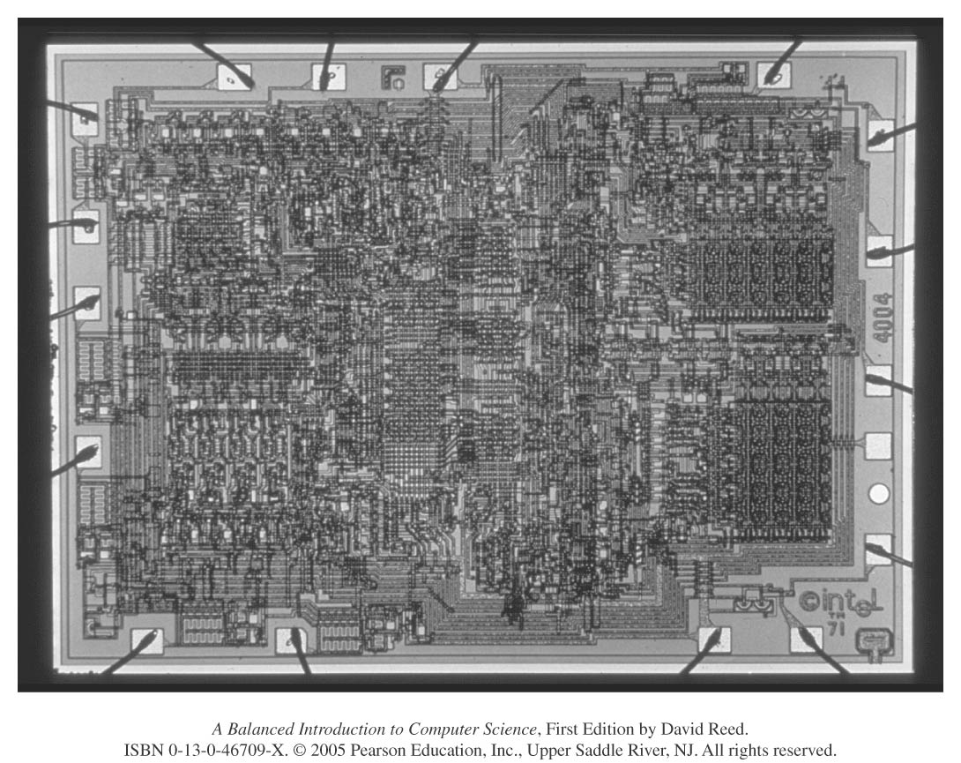
From Circuits to Microchips
initially, circuits were built by wiring together individual transistors
  this did not lend itself to mass production
  it also meant that even simple circuits consisting of tens or hundreds of transistors were quite large (to allow space for human hands)
in 1958, two researchers (Jack Kilby and Robert Noyce) independently developed techniques that allowed for the mass-production of circuitry
  circuitry (transistors + connections) is layered onto a single wafer of silicon, known as a microchip
  since every component is integrated onto the same microchip, these circuits became known as integrated circuits

Slide 48
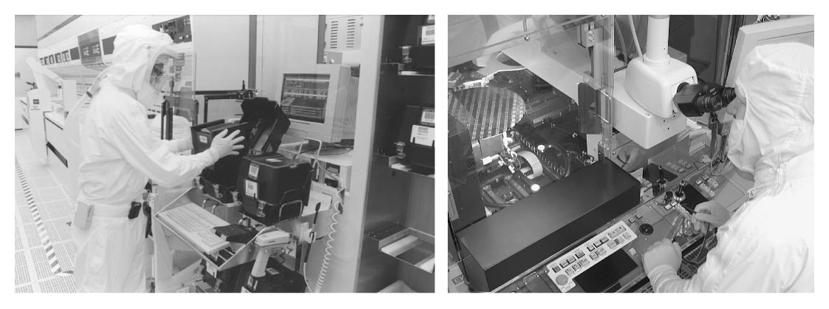
Manufacturing ICs
the production of integrated circuits is one of the most complex engineering processes in the world
  transistors on chips can be as small as .13 microns (roughly 1/750th the width of human hair)
  since a hair or dust particle can damage circuitry during manufacture, chips are created in climate-controlled "clean rooms"

Slide 49
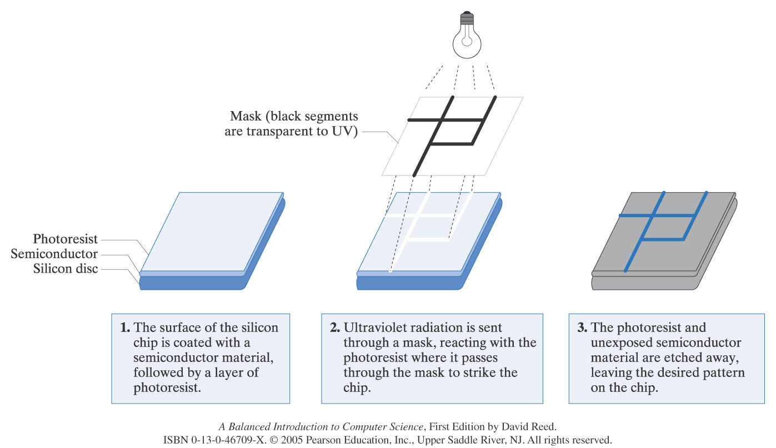
Manufacturing ICs
to produce the incredibly small and precise circuitry on microchips, manufacturers use light-sensitive chemicals
  initially, the silicon chip is covered with a semiconductor material, then coated with a layer of photoresist (a chemical sensitive to UV light)
  transistors are then printed onto a mask (transparent surface on which an opaque coating has been applied to form patterns)
  UV light is filtered through the mask, passing through the transparent portions and striking the surface of the chip in the specified pattern
  the photoresist that is exposed to the UV light reacts, hardening the layer of the semiconductor below it
  the photoresist that was not exposed and the soft layer of semiconductor below are etched away, leaving only the desired pattern of semiconductor material on the surface of the chip
  the process can be repeated 20-30 times depositing multiple layers

Slide 50
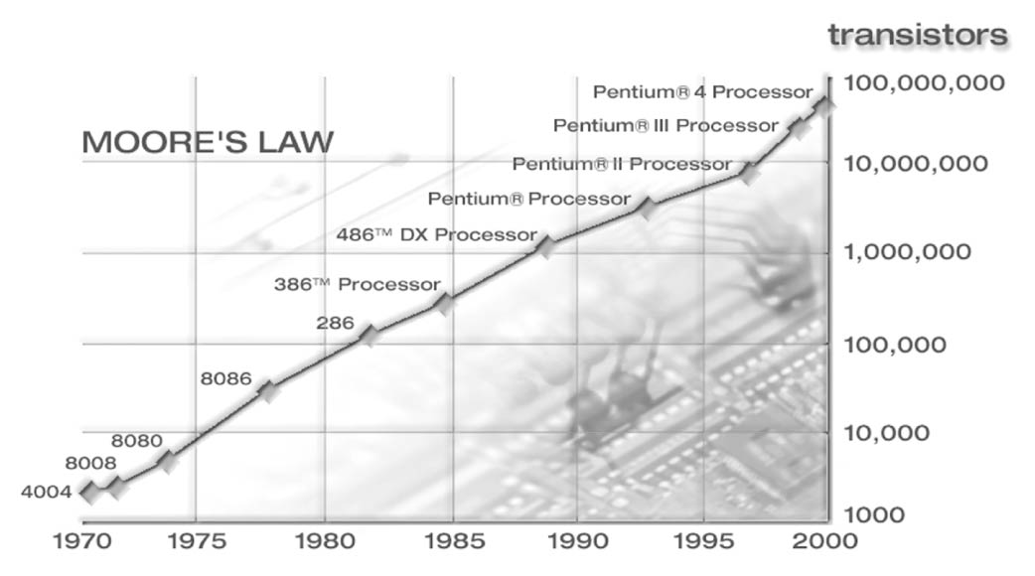
Packaging Microchips
since a silicon chip is fragile, the chip is encased in plastic for protection
  metal pins are inserted on both sides of the packaging, facilitating easy connections to other microchips
impact of the microchip
  lower cost due to mass production
  faster operation speed due to the close proximity of circuits on chips
  simpler design/construction of computers using prepackaged components
Moore’s Law describes the remarkable evolution of manufacturing technology
  Moore noted that the number of transistors that can fit on a microchip doubles every 12 to 18 months
  this pattern has held true for the past 30 years
  industry analysts predict that it will continue to hold for the near future

